Slide 1
Unit 1: Introduction to ASP.NET

Slide 2
Lesson: Overview of ASP.NET
What is ASP.NET?
ASP.NET Web Application
Multimedia: ASP.NET Execution Model

Slide 3
What is ASP.NET?
Evolutionary, more flexible successor to Active Server Pages
Dynamic Web pages that can access server resources
Server-side processing of Web Forms
XML Web services let you create distributed Web applications
Browser-independent
Language-independent

Slide 4
ASP.NET Web Application
ASP.NET Web Server
Clients
Web Forms
Page1. aspx
Web. config
Code-behind pages
Output Cache
Internet
Page2. aspx
machine. config
global. asax
Web Services
Database
Components
XML Data

Slide 5

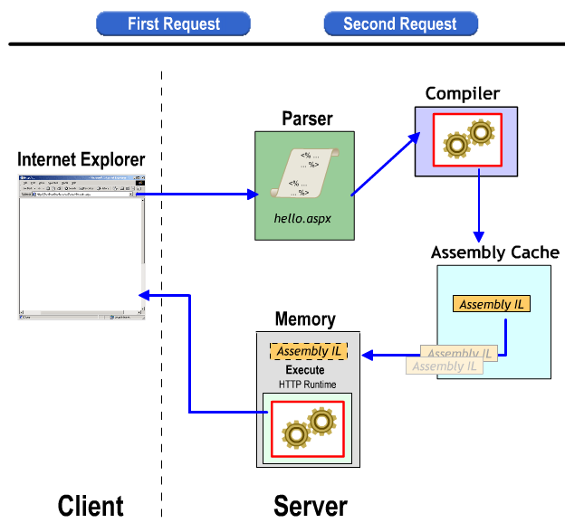

Multimedia: ASP.NET Execution Model
Demo: Lesson03.1_ASP.NET Execution model.swf
Lesson03.1_Client side and server side processing.swf

Slide 6
DEMO
Run in IE:
Lesson03.1_ASP.NET Execution model.swf
Lesson03.1_Client side and server side processing.swf

